Slide 1

Graphs
CISC 610
Data Structures & Algorithms
Caleb Druckemiller, MSC

Slide 2
What are we doing today?
Graphs
Terminology and Definitions
Types of Graphs
Ways to Implement Graphs
Algorithms
Traversals & Path-finding
Creating Minimum Spanning Trees
Other Useful Algorithms
Examples for Uses

Slide 3
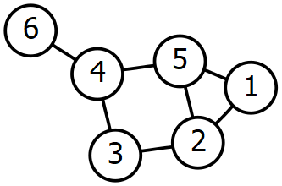
What is a graph?
Definitions:
A set of vertices and edges that form connections between the vertices
“[A] structure amounting to a set of objects in which some pairs of the objects are in some sense ‘related’” [Wikipedia]
A tree with cycles (Remember: trees are acyclic graphs)
This thing:

Slide 4

Definitions & Terminology
Definitions:
Graph
A graph, $G$, is defined as $G=\{V,E\}$ where $V$ is the set of vertices and $E$ the set of edges
Vertex
An element of a graph
The mathematically abstracted concept that the graph describes relationships between
Also sometimes called “points” or “nodes”
Plural is vertices or vertexes (both are technically valid)

Slide 5
Definitions & Terminology
Definitions:
Edge
A connection between two vertices showing a relationship
The nature of that relationship is specific to the graph
The two vertices do not need to be distinct
An edge can attach a vertex to itself

Slide 6

Definitions & Terminology
Definitions:
Edge
A connection between two vertices showing a relationship
The nature of that relationship is specific to the graph
The two vertices do not need to be distinct
An edge can attach a vertex to itself
There are different types of edges within graphs which describe different kinds of relationship (more to come)

Slide 7
Definitions & Terminology
Definitions:
Adjacent Nodes
Nodes that are endpoints to the same edge
Degree of a Vertex
The number of edges that are incident to (the node is an endpoint for)
Degree of Node 1 is 2
Degree of Node 5 is 3
Leaf Vertex
A vertex with a degree of 1

Slide 8
A Note about Graph Diagrams
The diagram that we use accurately depicts:
The elements of the graph (vertices)
Relationships between elements (edges)
Adjacency of elements
NOTHING ELSE IS ACCURATE OR RELEVANT. This includes:
Position
Proximity/Distance between vertices
Crossing of edges does not matter
This means our graph is equivalent to this graph:

Slide 9
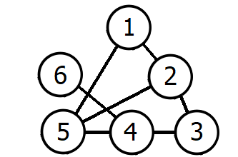
A Note about Graph Diagrams
The diagram that we use accurately depicts:
The elements of the graph (vertices)
Relationships between elements (edges)
Adjacency of elements
NOTHING ELSE IS ACCURATE OR RELEVANT. This includes:
Position
Proximity/Distance between vertices
Crossing of edges does not matter
This means our graph is equivalent to this graph:

Slide 10
Definitions & Terminology
Definitions:
Path
A sequence of nodes (or edges) to get from one node to another
The same as in trees
Cycle or Loop
A path that begins on a node, leaves the node across an edge, and ends on the initial node

Slide 11
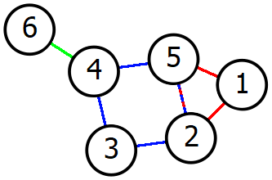
Definitions & Terminology
Definitions:
Path
A sequence of nodes (or edges) to get from one node to another
The same as in trees
Cycle or Loop
A path that begins on a node, leaves the node across an edge, and ends on the initial node
Notice the blue and red cycles in the sample graph
What about the green edge? Can it be involved in a cycle?

Slide 12

Types of Graphs
Definitions:
Subgraph
A graph, $G^{′}=\{V^{′}, E^{′}\}$, is a subgraph of G if:
$V^{′}⊆V$ (the elements of $V^{′}$ form a subset of $V$)
And $E^{′}⊆E$
Connected Graph
A graph where there’s a valid path from each vertex to every other vertex
The above is a connected graph

Slide 13


Types of Graphs
Definitions:
Subgraph
A graph, $G^{′}=\{V^{′}, E^{′}\}$, is a subgraph of G if:
$V^{′}⊆V$ (the elements of $V^{′}$ form a subset of $V$)
And $E^{′}⊆E$
Connected Graph
A graph where there’s a valid path from each vertex to every other vertex
This is an example of an unconnected graph

Slide 14
Types of Graphs
Definitions:
Simple Graph
A graph where any two nodes are connected by no more than one edge
This is the typical version of a graph you will encounter
Multigraph
A graph where any two nodes can be connected by an arbitrary number of edges

Slide 15

Types of Graphs
Definitions:
Simple Graph
A graph where any two nodes are connected by no more than one edge
This is the typical version of a graph you will encounter
Multigraph
A graph where any two nodes can be connected by an arbitrary number of edges

Slide 16
Types of Graphs
Definitions:
Directed Graph
A graph where the edges between vertices convey both adjacency AND direction
Our example graph has been “undirected”
Edges do not contain direction information
This means that traversals on an edge can happen in either direction
Node 3 is adjacent to Node 4
Node 4 is adjacent to Node 3

Slide 17

Types of Graphs
Definitions:
Directed Graph
A graph where the edges between vertices convey both adjacency AND direction
Traversals can happen only happen in one direction
Node 3 is adjacent to Node 4
Node 4 is NOT adjacent to Node 3
Two edges are needed to have adjacency per undirected graphs
Is this graph connected or unconnected?

Slide 18
Types of Graphs
Definitions:
Directed Graph Terminology
Indegree & Outdegree
The number of edges going into or out of a vertex, respectively
Source Vertex
A vertex with an indegree of 0
Sink Vertex
A vertex with an outdegree of 0

Slide 19
Types of Graphs
Definitions:
Unweighted Graph
A graph where the edges are considered of equal weight or importance
We can calculate the distance of any path
Each edge on a path is counted singularly
In 1’s
Example: Distance across the path 6-4-5-1
Cost of 3

Slide 20

Types of Graphs
Definitions:
Weighted Graph
A graph where each edge has a weight
We can calculate the distance of any path
Add the weight of each edge across the path
Example: Distance across the path 6-4-5-1
Cost of 3+2+4 = 9
Again: proximity in the diagram does not represent actual proximity
What is the shortest from Node 6 to Node 3?

Slide 21
Okay, Okay, Enough Definitions!
I hope it’s obvious at this point how this sort of data structure could be useful
But how do we implement it?
Three obvious options:
Objects for Each Aspect of the Graph
Adjacency Lists
Adjacency Matrix

Slide 22
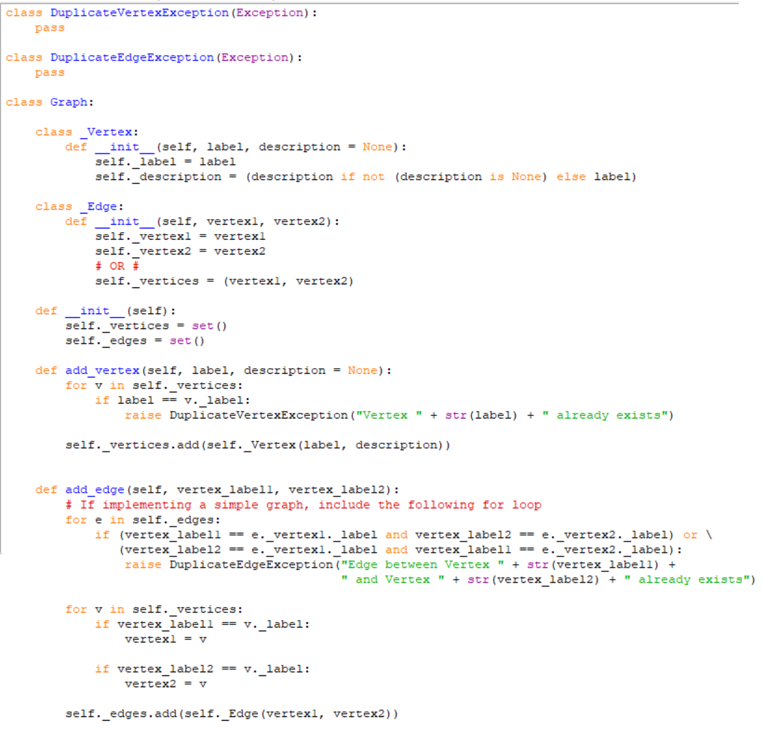

Objects for Each Aspect of the Graph
We’re programming in an object-oriented language
Let’s get object-oriented!
A graph, $G$, is defined as $G=\{V,E\}$ where $V$ is the set of vertices and $E$ the set of edges
Our Graph object will contain a set of Vertex objects and a set of Edge objects
Our Vertex object could contain things like a label and a description
Our Edge object could contain references to the two Vertex objects it connects

Slide 23
Objects for Each Aspect of the Graph
Let’s analyze this:
Approach is logical and fits the object-oriented paradigm
Objects are mostly wrappers for information
Provide very little, meaningful behavior enhancement
Detecting “equality” between objects is either:
Cumbersome in the Graph object
Requires additional infrastructure in _Vertex and _Edge
Wrapping in these objects are less memory and runtime efficient
Looking inside the objects requires effort
Code-wise, this is probably more pain than it’s worth

Slide 24
Objects for Each Aspect of the Graph
Let’s analyze this:
What about our inheritance hierarchy?
Graph is a simple graph
We could also have a WeightedGraph, a DirectedGraph, and a WeightedDirectedGraph
WeightedGraph and DirectedGraph
Who will WeightedDirectedGraph inherit from?
We CAN do multiple inheritance but it’s frowned upon
In conclusion, this seems like a logical approach but probably isn’t worth it.

Slide 25
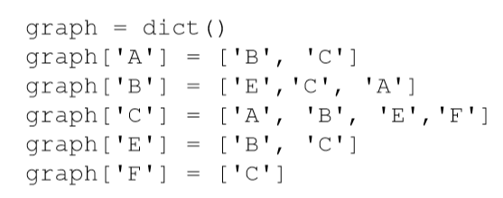
Adjacency List
Let’s drop the fancy object wrappers
Our graph can simply be a group of vertex labels and a list of adjacencies for that vertex
What would a reasonable data structure be?
How could we implement a directed graph?
How could we implement a weighted graph?

Slide 26
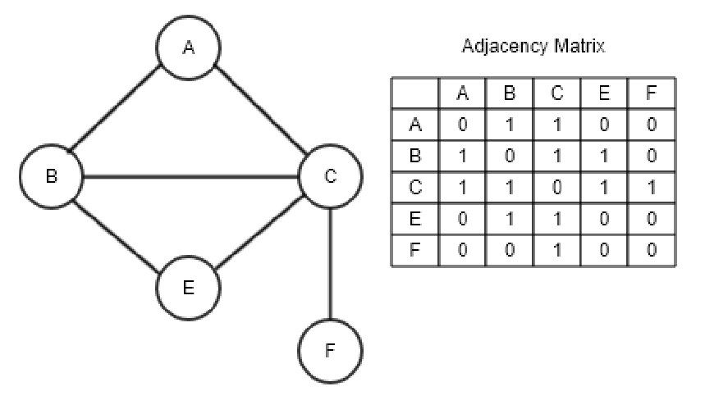
Adjacency Matrix
The other option is to store connections in a matrix
We still must store our vertices in some sort of linear structure
How could we implement a directed graph?
How could we implement a weighted graph?

Slide 27
List or Matrix
Which is better?
Depends on the need and usage
Which one is more memory efficient?
Is the graph sparsely or heavily connected?
Which is easier to find if there’s an edge between vertices?
Which is easier to dynamically add vertices to/remove vertices from?
Which is easier to dynamically add edges to/remove edges from?
The “better” implementation will be determined by your needs and the usage of the graph

Slide 28
Tree Traversal
Graphs, as a whole, contain a lot of interesting and useful data
However, sometimes we will need to move through a graph to capture specific information
How do we get from Node 1 to Node 12?
What are all the ways to get from Node 1 to Node 12?
What is the best/fastest way to get from Node 1 to Node 12?
What does this sound like?
Searching
How do we do this?

Slide 29
Tree Traversal
Think back to our definitions for graphs:
A set of vertices and edges that form connections between the vertices
“[A] structure amounting to a set of objects in which some pairs of the objects are in some sense ‘related’” [Wikipedia]
A tree with cycles (Remember: trees are acyclic graphs)
Since it is just a tree with cycles, we could always use the same algorithms and approaches as we did with trees

Slide 30
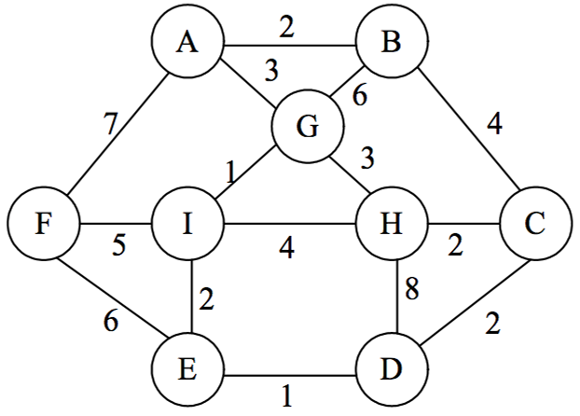
Breadth-First Traversal/Search
Let’s start by re-examining BFT/BFS
Breadth-first traversal examines all nodes at a level before moving to the next level using the algorithm:
Add the root to a FIFO queue
While the desired element has not been found and there are still elements in the queue
Dequeue a node
If the node doesn’t have the desired element
Add the current node’s children to the queue

Slide 31

Breadth-First Traversal/Search Performance
Analysis
Efficiency:
$O(\left|E\right|+\left|V\right|)$
Remember $O(\left|E\right|)$ can be between $O(1)$ and $O\left({\left|V\right|}^{2}\right)$
Memory intensive
Weak for deep nodes on wide trees
Complete algorithm on graphs
Goal state will always be found
How do we know this?

Slide 32
BFS Completeness
How do we know that the goal state will always* be found?
Where “always” means “within a connected graph”
Informally:
All adjacent nodes of the first are added to our queue
Assume that our first node is adjacent to itself
Therefore, it’s in the queue. What is the worst place for it?
First in the queue. (We have made no progress.)
Process it again. All adjacent nodes get queued.
Then we get to the next adjacent node of the first node
We have progressed!

Slide 33
BFS Completeness
How do we know that the goal state will always* be found?
Where “always” means “within a connected graph”
Informally:
Okay, what if we haven’t progressed?
This means that we are still on the very first node
Therefore, this means that the first node is ONLY adjacent to itself
Therefore, you are either:
Searching for a node that doesn’t exist
Or are searching in a tree that isn’t connected

Slide 34
Pure Depth-First Traversal/Search
Depth-first traversal considers a path all the way to a leaf node before considering a new path using the algorithm:
For all children of the current node
Recursively visit the left children
Recursively visit the right children
When is the current node checked?
Depends on the type of DFS
Pre, In, or Post-order

Slide 35

Depth-First Traversal/Search Performance
Analysis
Efficiency:
$O(\left|E\right|+\left|V\right|)$
Memory efficient
Weak for wide nodes on deep trees
Incomplete algorithm on graphs
Goal state will not always be found
How do we know this?

Slide 36
DFS Completeness
How do we know that the goal state may not be found?
Consider our previous informal proof:
Assume that our first node is adjacent to itself
What would be the worst time to encounter it?
First. (We have made no progress.)
Process it again
Since it wasn’t the desired node, we need to keep going
What will be the next node that we see?
The first node again. (If it was the next node the first time…)

Slide 37
DFS Completeness
How do we know that the goal state may not be found?
We have encountered an infinite loop
Is there a way to alter DFS so that it is a complete algorithm?
Give it memory of where it’s been
Every time a node is encountered, add it to a list of visited nodes
Never traverse again to a node that already has been seen
Sort of treat the graph like an unofficial tree
(Hold onto that thought for a minute…)
Also, memory can be added to BFS (to improve runtime)

Slide 38
Complete Depth-First Traversal/Search
Depth-first traversal considers a path all the way to a leaf node before considering a new path using the algorithm:
Add the root to the list of visited nodes
For all children of the current node
If child hasn’t been visited, recursively visit the left children
If child hasn’t been visited, recursively visit the right children
This was the algorithm from our tree traversal
However, there the memory was optional (in brackets)
Why? Why are “infinite loops” not an issue there?

Slide 39
Alternate DFS Approaches
Depth-Limited Search
DFS where a maximum depth is set
Goal is to prevent cycles of the “graph based” approach
Iteratively Deepening Search
Depth-limited where the maximum depth increases
Seems costly as states and paths will be repeated many times
Why is that mitigated?
Where are most of the nodes?
What is the relative size of a tree/speed of the algorithm at a shallow depth?

Slide 40
Graphs as Trees
In our complete DFS implementation, we acted like the graph was a tree
Done using a greedy approach
Traverse as far as you can before stopping & doubly back
If we used some planning, could we do better?
Could we turn graphs into equivalent trees?
Would there be a benefit to making these trees as lightweight as possible?
The answer to all of these questions is “Yes”

Slide 41
Tree Creation Algorithms
Any tree:
Really, any tree traversal algorithm
Breadth or Depth-First Search are typically used
Problems/Inefficencies can arise as previously mentioned
Minimum Spanning Tree:
A tree which connects every node and has the minimum possible weight
Prim’s/Prim–Dijkstra algorithm
Kruskal's algorithm
Borůvka’s, Reverse-Delete, Single-Linkage Clustering…

Slide 42

Prim’s/Prim–Dijkstra algorithm
Developed in 1930 by Czech mathematician Vojtěch Jarník
Republished by Prim & Dijkstra in the late 1950’s
Algorithm:
Initialize a tree with a single vertex, chosen randomly
Grow the tree by one edge
Add the min weight edge that connects the tree vertices to the nodes not yet in the tree
Repeat
Efficiency
Adjacency matrix: $O(|V^{2}|)$, Fib. Heap: $O(\left|E\right|+|V|\log{|V|})$

Slide 43
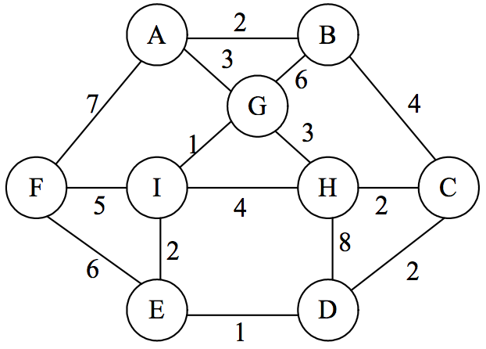
Prim Algorithm Example
Given this graph:
Start at G
What is our first edge?
What else is added?
Complete the graph

Slide 44

Kruskal's algorithm
Published in 1956. Created by American Joseph Kruskal
Algorithm:
Create an equivalent graph/forest (F) with no edges
Create a set (S) containing all the edges in the graph
Remove an edge with minimum weight from S
If the removed edge connects two different trees from F then add it to the forest F, combining two trees into a single tree
Repeat
Efficiency (if edges are sorted): $O(\left|E\right|+|V|\log{|V|})$

Slide 45
Kruskal's algorithm
Given this graph:
What is our forest?
What is our set S?
What is our first added edge?
What is next?
Keep going…

Slide 46
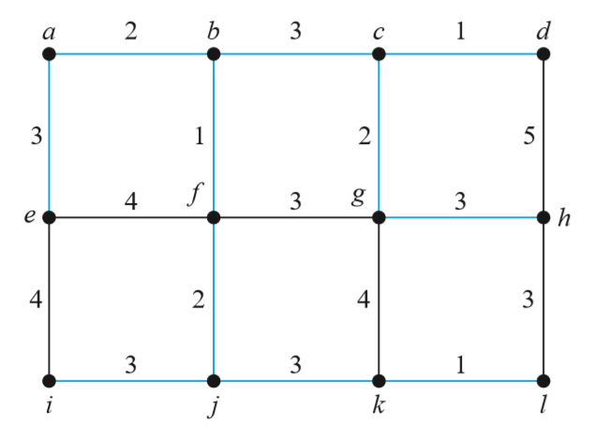
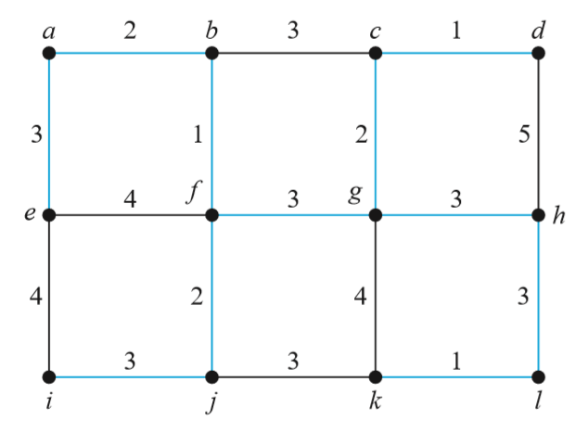
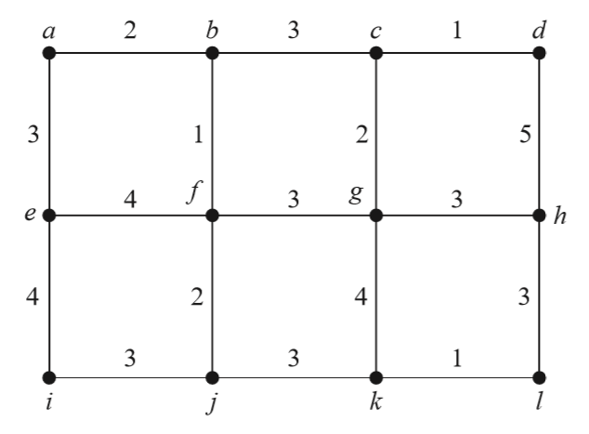
Do we always get the same tree?
Show me.

Slide 47
Can We Do Even Better?
Minimum spanning trees give you a tree of minimum weight that connects all nodes
Paths within that tree are not necessarily minimal between nodes
Sometimes we need to know the shortest path between one node and all other nodes
Can we do this?

Slide 48
Dijkstra’s Algorithm
Shortest path algorithm created in 1956 by Edsger Dijkstra
Uninformed, best-first, and not greedy
Can be used to find the shortest distance to one node OR create a shortest-distance spanning tree
Different than a minimum spanning tree as we are finding the shortest distance from the source to each node
Iteratively find the best route to the next node until the destination is found

Slide 49
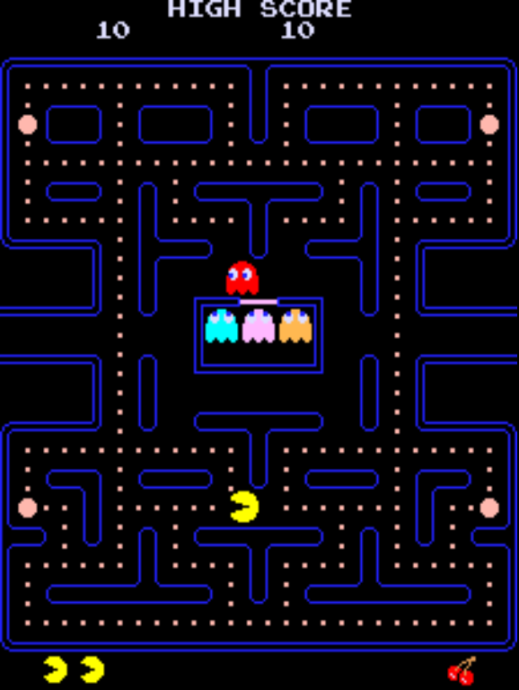
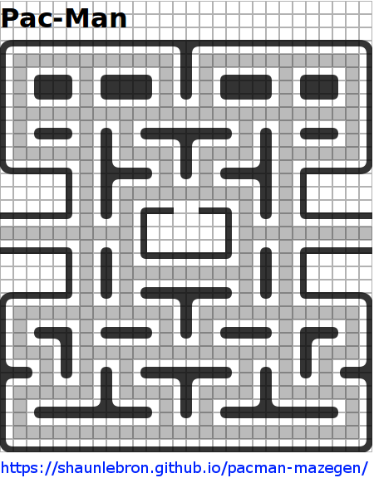
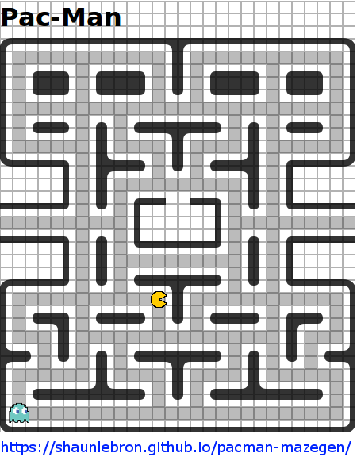
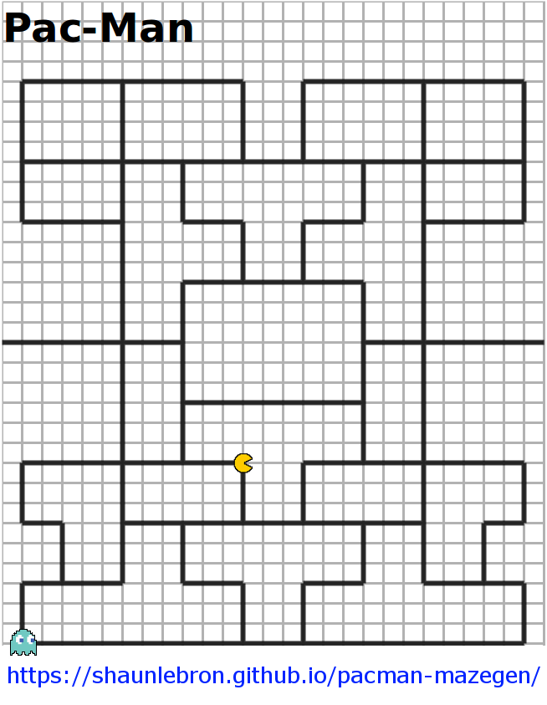
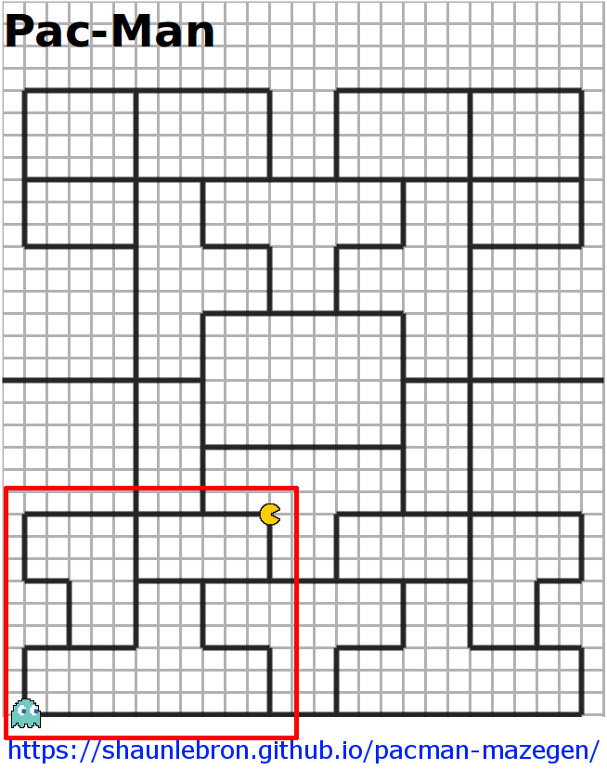
Dijkstra’s Algorithm Example

Slide 50
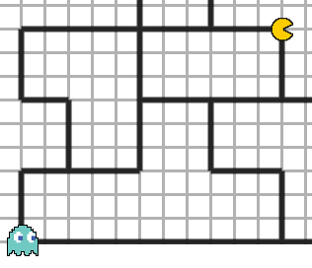
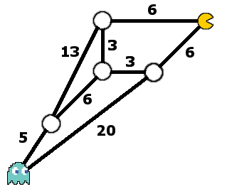
Dijkstra’s Algorithm Example

Slide 51
Dijkstra’s Algorithm Example
Data structures for this algorithm:
A collection of nodes in the graph & their currently established distance from the source node
(Ordered from closest to furthest, if we can swing it)
A collection of previous visited nodes
A collection of parent nodes for each shortest path
A way to return the shortest path

Slide 52
Dijkstra’s Algorithm Example
Setup:
For each node in the graph
If the node is not the source
Add it to a pool of nodes to visit
Set best distance to that node as infinite
Else, the node is the source
Add it to a pool of nodes visit
Set best distance to that node as 0
Set node’s parent to be unknown

Slide 53
Dijkstra’s Algorithm Example
Setup:
While the next node in the pool is not the destination (path)/ pool is not empty (tree)
Remove next node from the pool
Add node to the visited nodes
For each neighbor of the current node
If the current neighbor is still in the pool & the distance to it is the shortest yet
Set the shortest distance as the current
Set the current node as the parent

Slide 54
Dijkstra’s Algorithm Example
Path Assembly:
Set the current node to the destination & add it to the path
While the current node isn't the source node
Get the current node's parent and set it as the current node
Add the new current node to the path
Path is complete but backwards so reverse the path and return it

Slide 55
Dijkstra’s Algorithm Example
Tree Assembly:
Create a list of all nodes
Create a tree with the source node as root
While the list of nodes isn’t empty
Grab and remove a node
While the current node isn’t in tree
Get the current node's parent and set it as the current node
Add the new current node to the path
Remove the new current node from the list of all nodes
Append the current path to the tree as a branch at the current node
Tree is complete but backwards so reverse each branch/path and return it

Slide 56
Dijkstra’s Algorithm Analysis
Analysis
Fast enough → O(|V|²)
We can get it faster
Replace the list-based priority queue with a heap-based priority queue
O(|E| + |V| log |V|)
The fastest way to get the shortest path! Guaranteed!*
*The fastest known single-source shortest-path algorithm for arbitrary directed graphs with unbounded non-negative weights. Offer not valid in all 50 states.

Slide 57
Can We Do Better?
Dijkstra can visit many unnecessary nodes
Dijkstra is naive
What if we had an algorithm who understood “the world” a little better?

Slide 58
A*
Heuristic-based
Function that estimates the next best move
Uses it to help choose the next node to expand
Dijkstra chooses “the visited node closest to the source”
f(x) = g(x) where g(x) is the shortest distance to x
A* chooses “the visited node contained within the shortest estimated trip from source to destination”
f(x) = g(x) + h(x)
In our case, h(x) = straight-line distance from x to the target node

Slide 59
A* Analysis
Some notes:
Note that h(x) is “optimistic”
Must be optimistic for heuristic to be admissible
Given an admissible heuristic, A* considers the fewest nodes of any admissible search algorithm!¤
Hey, what’s the heuristic you could choose to make A* function identically to Dijsktra?
What is the ideal heuristic? Why is that impractical?
¤ Offer void if heuristic is not admissible.

Slide 60
Uses?
Obviously, this is a vast topic
Really, any information where links between aspects may exist or have different distances/intensities
Maps
Network diagrams
Organizational charts
Relationships
Contact Tracing
Social Networks
Item Similarity/Recommendation
Information Transmission
Software Dependencies
Finite State Machines
Road Networks
Currency Flow
etc.

Slide 61
Questions?

